Slide 1
Testing Concerns
What’s happening with the CC tests?
What are potential implications/dangers/safe havens available in ACT, SAT, Iowa?
State requirements for other tests?
Denise Donohue NAPCIS, Ave Maria University

Slide 2
Federally funded National Assessments
$175 million 4 yr. grant from US DOE to Smarter Balanced Assessment Consortium in 2010.
$185 million 4 yr. grant to Partnership for Assessment of Readiness for College and Careers (PARCC).
Three additional assessment companies are working on tests for students with severe cognitive disabilities and English language learners per ETS. (Funding not mentioned).
* Retrieved from www.smarterbalanced.org/resources-events/faqs and PARCConline.org
Notes:
Smarter Balanced literature states the federal grant award in 2010 was $330 million and they received $175 million. PARCC literature states they received $185 million grant over 4 year. This total $360 million. Not sure where the extra $30 million is from.
National Center and State Collaborative (NCSC) Partnership and the Dynamic Learning Maps (DLM) Alternate Assessment System Consortium for students with the most significant cognitive disabilities and the Assessment Services Supporting English Learners Through Technology Systems (ASSETS) Consortium for English-language learners. As reported by the Educational Testing Services (http://www.ets.org/K12/commonassessments).

Slide 3
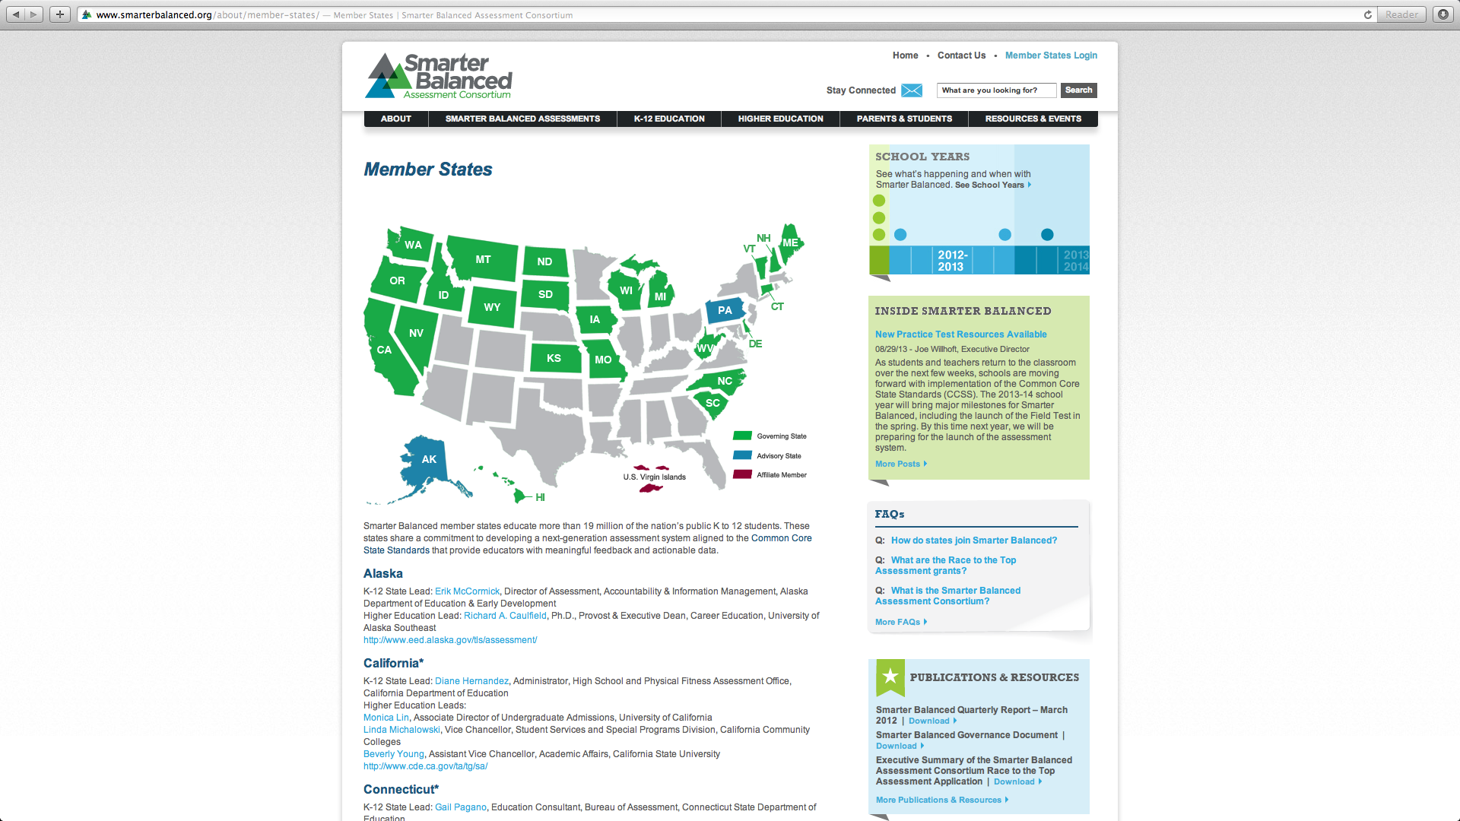
Smarter Balanced Assessment Consortium
Washington State,
Oregon, Idaho,
California, Nevada,
Wyoming, North
Dakota, South Dakota,
Kansas, Iowa, Wisconsin,
West Virginia, North
Carolina, South Carolina,
Delaware, Vermont,
Connecticut, Wisconsin,
New Hampshire, Maine,
Montana.
Michigan is vacillating at
this time.
Missouri & Utah withdrew.
Testing for grades 3-8, 11 22 States and 19 million students.
Notes:
Long time educator Linda Darling-Hammond is working with Smarter Balance. Currently operating out of the State of Washington’s Office of Superintendent of Public Instruction, but will move to UCLA’s Graduate school of Education and Information Studies after the final receipt of the federal grant money in 2014.
* www.smarterbalanced.org/resources-events/faqs

Slide 4
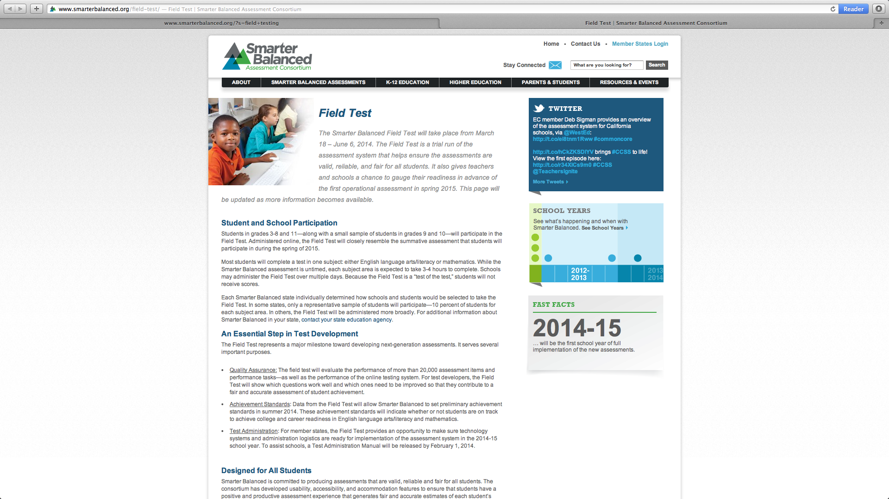
Field testing for Smarter Balanced Assessments are March 18 – June 6, 2014
Notes:
Will use between 15- 20% of students in governing states for testing for final revisions.

Slide 5
Number, type, and length of Tests developed by Smarter Balance
Interim Assessments – administered at locally determined times. “Involve a large teacher role in developing and scoring constructed response items and performance task”.
Summative, end-of-year, assessment - within last 12 weeks of school.
Computer adaptive and performance based. Allows for a quick turnaround time.
Cost between $22.50 - $27.30 per student (including scoring services that state must procure on their own).
Will have tests for ESE and ELLs.
Notes:
PARCC tests use the computer, but are not computer adaptive. Smarter Balance uses computer adaptive testing which adapts to the examinees ability level. Answering questions correctly means the student will next receive a more challenging question. Incorrect answers will generate less difficult questions.

Slide 6
Number, type, and length of Tests developed by Smarter Balance
Multiple choice, short constructed response, and extended constructed response.
Performance tasks allow students to complete an in-depth project that demonstrates analytical skills and real-world problem solving (Smarter balance: Frequently asked questions, p.3). Uses sets of connected, themed questions, scenarios. Will take one to two class periods to complete (not computer adaptive).
Designed as untimed tests estimated to take between 7 – 8 ½ hours.
Notes:
http://www.smarterbalanced.org/wordpress/wp-content/uploads/2011/12/Preliminary-Summative-Blueprints-Supporting-Document.pdf

Slide 7
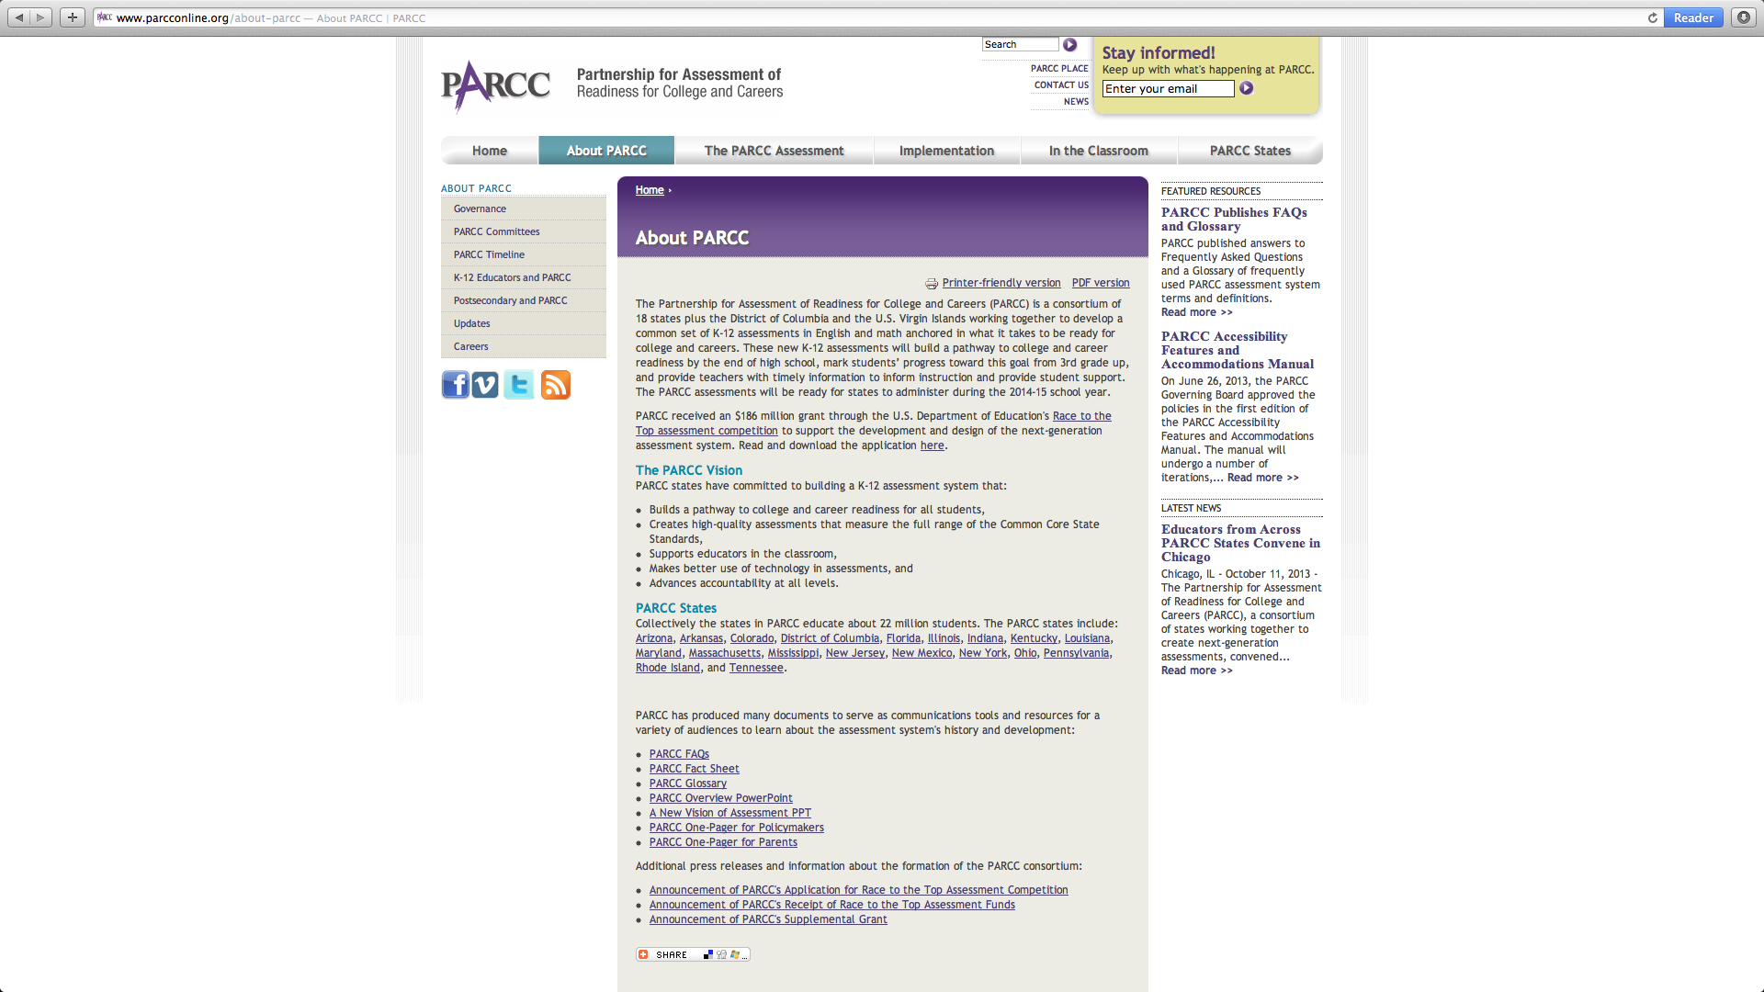
Partnership for Assessment of Readiness for College and Careers
Currently 14 governing States
and the District of Columbia.
Arizona, Arkansas,
Colorado, District of
Columbia, Illinois, Louisiana, Maryland, Massachusetts, Mississippi, New Jersey, New Mexico, New York, Ohio, Rhode Island, Tennessee.
Participating members
Kentucky, Florida, Pennsylvania.
Indiana, Georgia, Oklahoma, Alabama have withdrawn altogether.
Assessments are for grades 3-11 and are estimated by PARCC to include between
22-25 million children in these states.
Notes:
Governing states are using the CCSS for instruction and PARCC assessments. Participating states are using the CCSS only and my use other in-house assessments.
PARCC consortia have contracted with Pearson and ETS (Educational testing services) education professionals to develop these assessments (according to the ETS website). Drop out rate of states may increase cost per student that was estimated by the state of Florida to be between $22-29 per student.

Slide 8
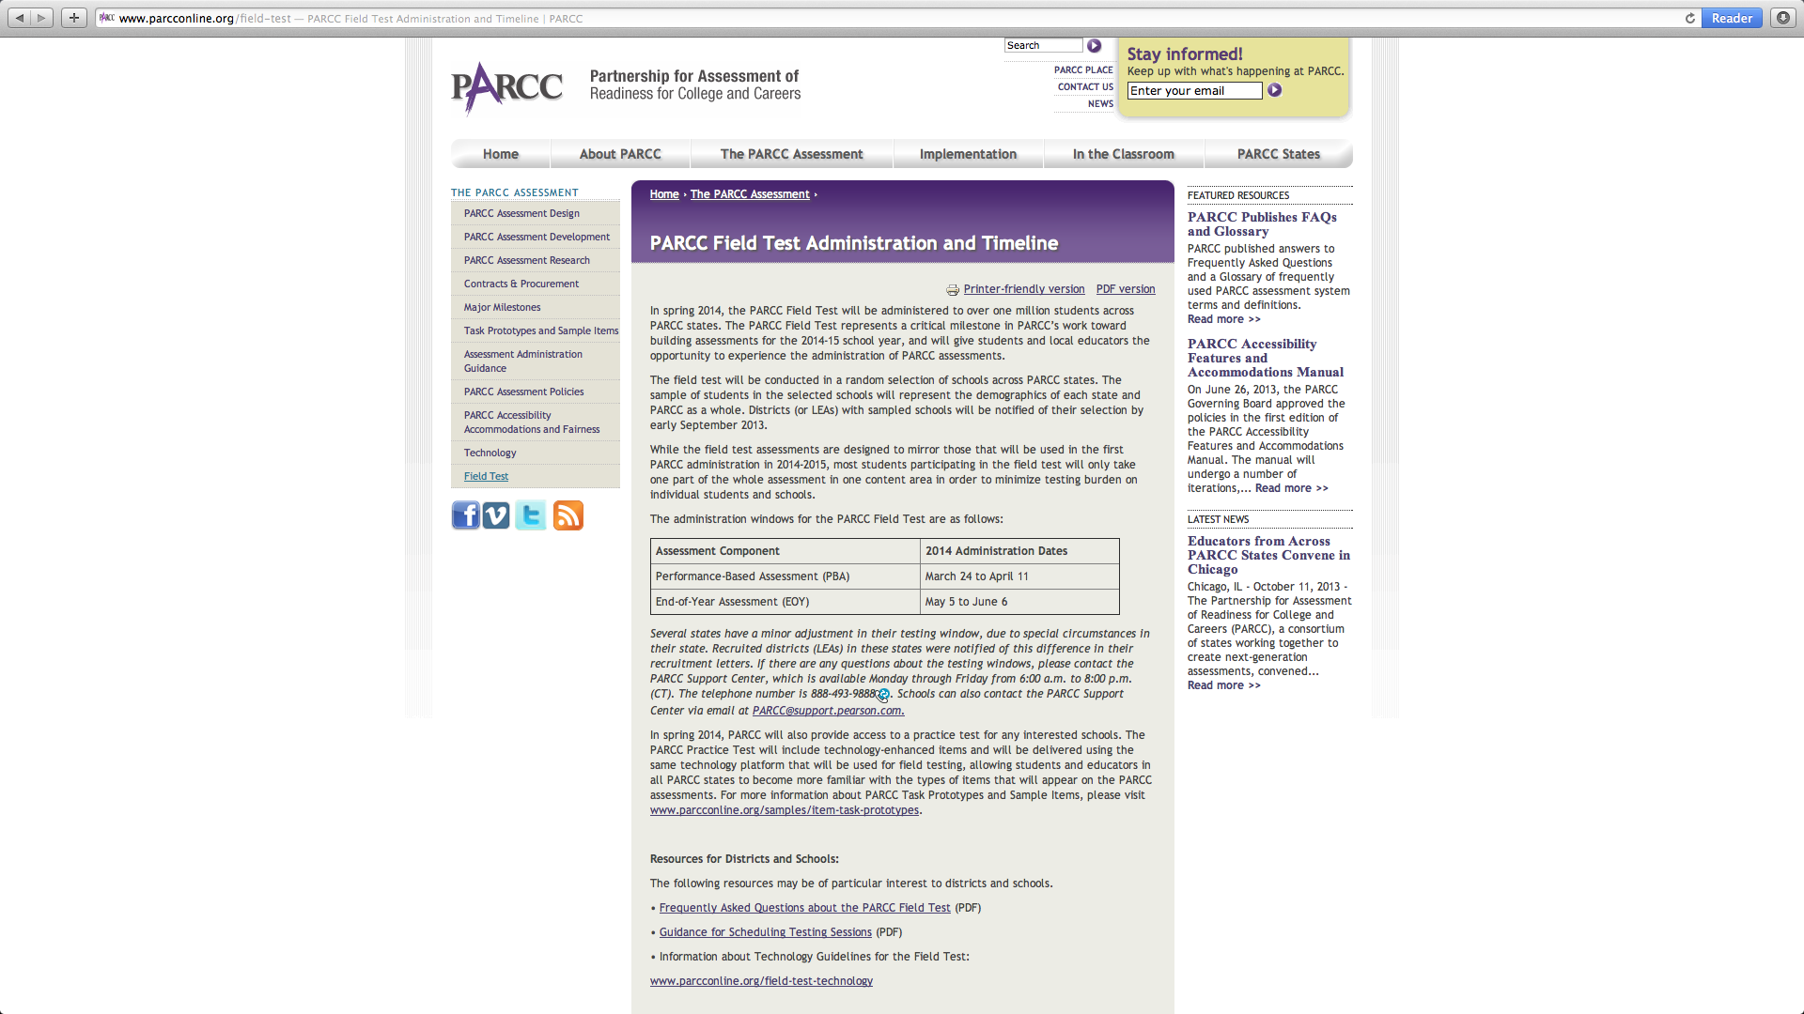
Field testing for PARCC Assessments are March 24 – April 11, 2014 for Performance Tests and May 5 – June 6, 2014 for End of Year Assessments

Slide 9
Number, type, and length of PARCC Assessments
As many as 7 separate tests throughout the year:
Diagnostics in reading, writing, and mathematics
Mid year assessments in ELA/literacy and mathematics
Performance-based in ELA/literacy and mathematics
End-of-Year Assessment in ELA/literacy and mathematics
Speaking and listening component (1 test) ELA/literacy and mathematics
Performance & EOY assessments in ELA/literacy and math: 8 hours annually in 3rd grade.
Just over 9 hours for Grades 4-5
A little less than 9 ½ hrs. for middle school
A little more than 9 ½ hrs. for high school
Notes:
Field testing in Spring 2014 with full-scale implementation of summative assessment in Spring 2015.
4 week end of year and performance based testing windows with a turnaround time by end of school year.
Does not take into account testing time for new Science, History, frameworks being created.
Will replace State exams. Will use online technology.
According to the Education Insiders Survey for October, PARCC is on the “right track”.

Slide 10
Use of PARCC for college entrance
Consideration of using PARCC End of Year assessment for higher education college acceptance “ultimately rests with the states, colleges and/or universities” (p.5).
“K-12 and higher education leaders in PARCC states are working together to develop the college and career-ready assessments to increase the likelihood higher education institutions will accept a PARCC College and career-ready Determination” (p.5).

Slide 11
Number of children effected by CCSS Assessments
Total number of school children in the U.S.(nces, 2013) 55 million
-Of this number 5.5 million are private school students (nces,2013)
Total covered by Common Core States 41 million
(As reported by PARCC & Smarter Balanced)
Total number of students not covered 14 million (25%)
Note: Catholic schools are not required to use these tests, although they were presented by the Center for Catholic School Effectiveness with source material in a presentation by Michelle Lia on April 12, 2012.
Notes:
4 states not implementing Common Core but creating their own assessments. Texas has STARR. Alabama left PARCC for the Aspire through ACT. Florida will test with the FCAT.

Slide 12
What assessments are available for these children?
Stanford 10 Aspire Iowa
Notes:
Generally private schools are required by state authorities (if they receive vouchers) or accrediting agencies to assess their students annually with standardized tests. This is for all students in grades K-12. While the national assessments will test only students in grades 3-8 and 11 or 3-11 depending upon what state you are in, test instruments exist for all grade levels and have been traditionally used by private and homeschools.

Slide 13
Stanford 10 Achievement Tests
Developed by Pearson.
Two different tests available: New and Classic
Normed group 2007 for the New Stanford 10 (prior to CCSS implementation).
Used for grades K-12.
Pricing is $9.28 per consumable, $7.78 for reusable and $2 for answer sheet.
Form A & Form D. Form A aligned to CCSS.
Designed to be administered during the later part of the school year – Spring.
Spring or Fall Norms.
Uses Otis-Lennon Ability Tests.
Notes:
Has full battery of exams including social studies, science components. Administration time is _________________. Diagnostics? Mid-year assessments?

Slide 14
Stanford 10 Achievement Tests
New
Classic
Reading, Language – IRA/NCTE Standards.
Mathematics - Uses NCTM Principles and Standards for School.
Social Sciences- Geography for Life: National Geography Standards & National Standards for Civic Government & Voluntary National Content Standards in Economics.
Science – “Current science practice & research” “Aligns with state standards” http://www.pearsonassessments.com/haiweb/cultures/en-us/productdetail.htm?pid=SAT10C - under Content.
Reading, Language – NAEP*
Mathematics – NAEP
Social Sciences - National Council for the Social Sciences (NCSS) Curriculum Standards for SS, National Content Standards.
Science – National Research Council, National Science Education Standards & The Benchmarks for Science Literacy (American Association for Advancement of Science).
*Susan Pimentel, lead writer of CCSS, is the VP of NAEP governing board
www.nagb.org/who-we-are/members/bios/b_pimentel.html
Notes:
IRA – International Reading Association
NCTE – National Council of Teachers of English
Voluntary National Content Standards in Econ. – 53% Funded by foundations, 6% funded by grants, 7% by individuals

Slide 15
Aspire
New test in development by ACT.
Designed for grades 3-8 and 9/10th
Are currently being field tested and will be launched in Spring 2014.
Has an accommodation module that supports audio support, sign language, and braille.
Spanish assessment for grades 3-6.
At this point the turn around time is estimated to be 4-6 weeks for the pencil & paper option. (This option is not mentioned on the website. Info obtained from phone call.)
Notes:
Georgia is considering using this assessment instead of CCSS.

Slide 16
Aspire cont’d
The reports will be tied to the ACT 1-36 Career and college readiness scale.
Will have student constructed response items, but not announced who, or how, these will be graded.
Fully aligned to Common Core.
Cost not determined.
Computer based option is workable on current releases or earlier of computer operating systems.

Slide 17
Iowa Forms E & F
Parallel forms developed by University of Iowa and marketed by Riverside Publishing Co.
Normed 2011 (during early release of CCSS) and good for 5-10 years before new norming is performed. (2016)
Development of Form E was “informed” by framework copies of CCSS, national standards, and from other multiple associations.
Uses multiple measures within each indicator to assess cognition: Essential is recall, Conceptual is two steps (inference), Extended is multiple steps.

Slide 18
Iowa Form E & F Cont’d
DataManager is in-house report generator maintained by in-house Test Administrator.
Can toggle between traditional reports and Common Core reports.
Can perform filtered reports by populations.
Has beginning and mid-year interim assessments.
All data maintained in-house.
Can administer with paper and pencil or online.
DataManager is purchased with Form E or F only (not previous versions).
Uses the Cogat Form 7 for ability.
Spring or Fall norms. (Kindergarten is Spring only for Reading).
Cost is $10.08 Grades K-3 and $7.43 Grades 4-12 (need to purchase answer sheet). This includes the DataManager option.
Longest testing time for full battery is 4 hr. 55 min.
Notes:
Older versions have older norms. State of Washington compared using the Iowa tests to PARCC and Smarter Balance and concluded that Iowa would be less expensive and still adhere to all federal and state requirements.
Finne, L. (2012). Respected Iowa Test of Basic Skills is the most cost-effective way to meet national testing requirement.

Slide 19
State-developed tests
Florida will test with the FCAT.
2.9 million students.
Texas has the STARR test (2012).
3.1 million students (grades 3-8, EOC)
Virginia has Standards of Learning (SOL) tests (2012-13)
1.3 million students (grades 3,5,8, and EOC)
Nebraska has NeSa tests (2010 – 2012)(grades 3-8, 11)
332,138 students
Alaska has SBA (Standards Based Assessment) (grades 3-10)
132,935 students
Notes:
The state of Florida does not require private school students to take a standardized test only those receiving State funds for private school tuition. These students MAY take the FCAT or other statewide assessment or private school standardized assessment
Florida - http://www.floridaschoolchoice.org/information/private_schools/faqs.asp

Slide 20
What about college entrance exams?

Slide 21
ACT
CCSS adopted ACT’s definition of “ready for college and career”.
CCSS used the ACT longitudinal research identifying required knowledge and skills essential for post-secondary education and workforce training.
Notes:
“ACT has long defined college and career readiness as the acquisition of the knowledge and skills a student needs to enroll and succeed in credit-bearing, first-year courses at a postsecondary institution (such as a two- and four-year college, trade school, or technical school) without the need for remediation. ACT’s definition has since been adopted by the Common Core State Standards Initiative and provides a unifying goal for educators and policymakers to act upon” (p.1).
“Not only did the initiative (CCSS) draw on ACT’slongitudinal research identifying knowledge and skills that are essential for success in post secondary education and workforce training, but it also sought additional evidence such as standards from high-performing countries and states, academic research on learning progressions, and other resources to support the inclusion of each standard within the Common Core framework” (p.1).

Slide 22
Alignment between ACT and CCSS is significant.
ACT “Pledges” to “work with stakeholders to develop strategies and solutions that maximize the coverage of the Common Core State Standards to meet the future needs of states, districts, schools, and students”(p.2).
The ACT Course Standards called QualityCore, are empirically derived course standards developed by ACT for their “high school instructional program” and are 100% aligned to CCSS.

Slide 23
ACT is predominately aligned already.
ACT test alignment to Common Core State Standards (or CCSS alignment to ACT!)
ACT, (June 2010). The alignment of common core and ACT’s college and career readiness system. p.5.
Notes:
June 2010 table indicates 100% alignment in Language Standards and skills, 100% in Math content for grades 9-12, 88% for Mathematical practices, 100% for reading strands, 67% for literature and 60% for informational text.
When looking through the 304 page document indicating ACTs alignment with Common Core, one gets the impression that CCSS were derived from ACT’s tests in toto for grades 6-12, even though ACT focuses on grades 8 and above. Many criterion for CCSS grades 6-8 were aligned to ACT’s lowest assessment the EXPLORE designed to assess grades 8 & 9.

Slide 24
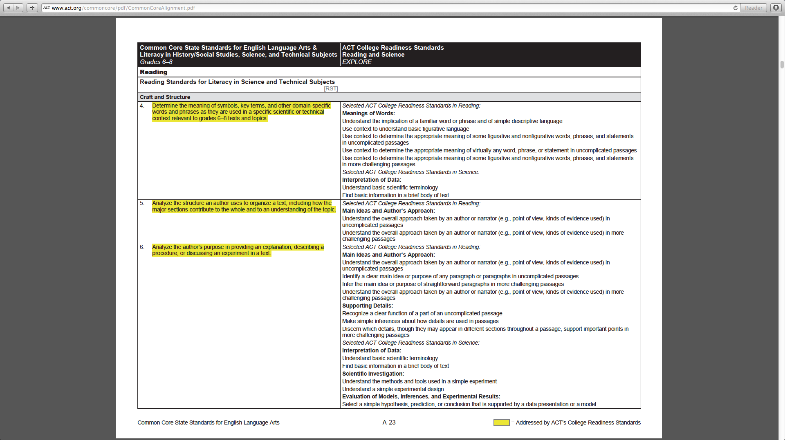
CCSS grades 6-8 ACT’s EXPLORE for grades 8 & 9
304 page document with similar comparisons

Slide 25
SAT
David Coleman, primary architect for Common Core State Standards, became president of the College Board in October 2012.
Announced in Feb. 2013, that SAT will change to align with CCSS.
SAT was previously aligned in 2005 to add writing component expending from 1600 to 2400 scoring and additional test time.
Concerned that ACT will become the test of choice for students as the number of test-takers taking the ACT surpassed the SAT test-takers in 2011.*
* Layton, L., & Anderson, N. (2013). College Board to make changes to SAT.
Notes:
Coleman graduated from Yale & Oxford and is a Rhodes scholar. Created Grow Network, an assessment program, that he sold to McGraw Hill in 2005. Founded Student Achievement Partners in 2007, funded by Gates Foundation and others, which led the writing of CCSS. He has never been a classroom teacher or school administrator. More than likely the writing piece of the SAT will change from narration to analytical, synthesis of data, with an included vocabulary section based on David Coleman’s comments made at the Brookings Institute in the fall of 2012.

Slide 26
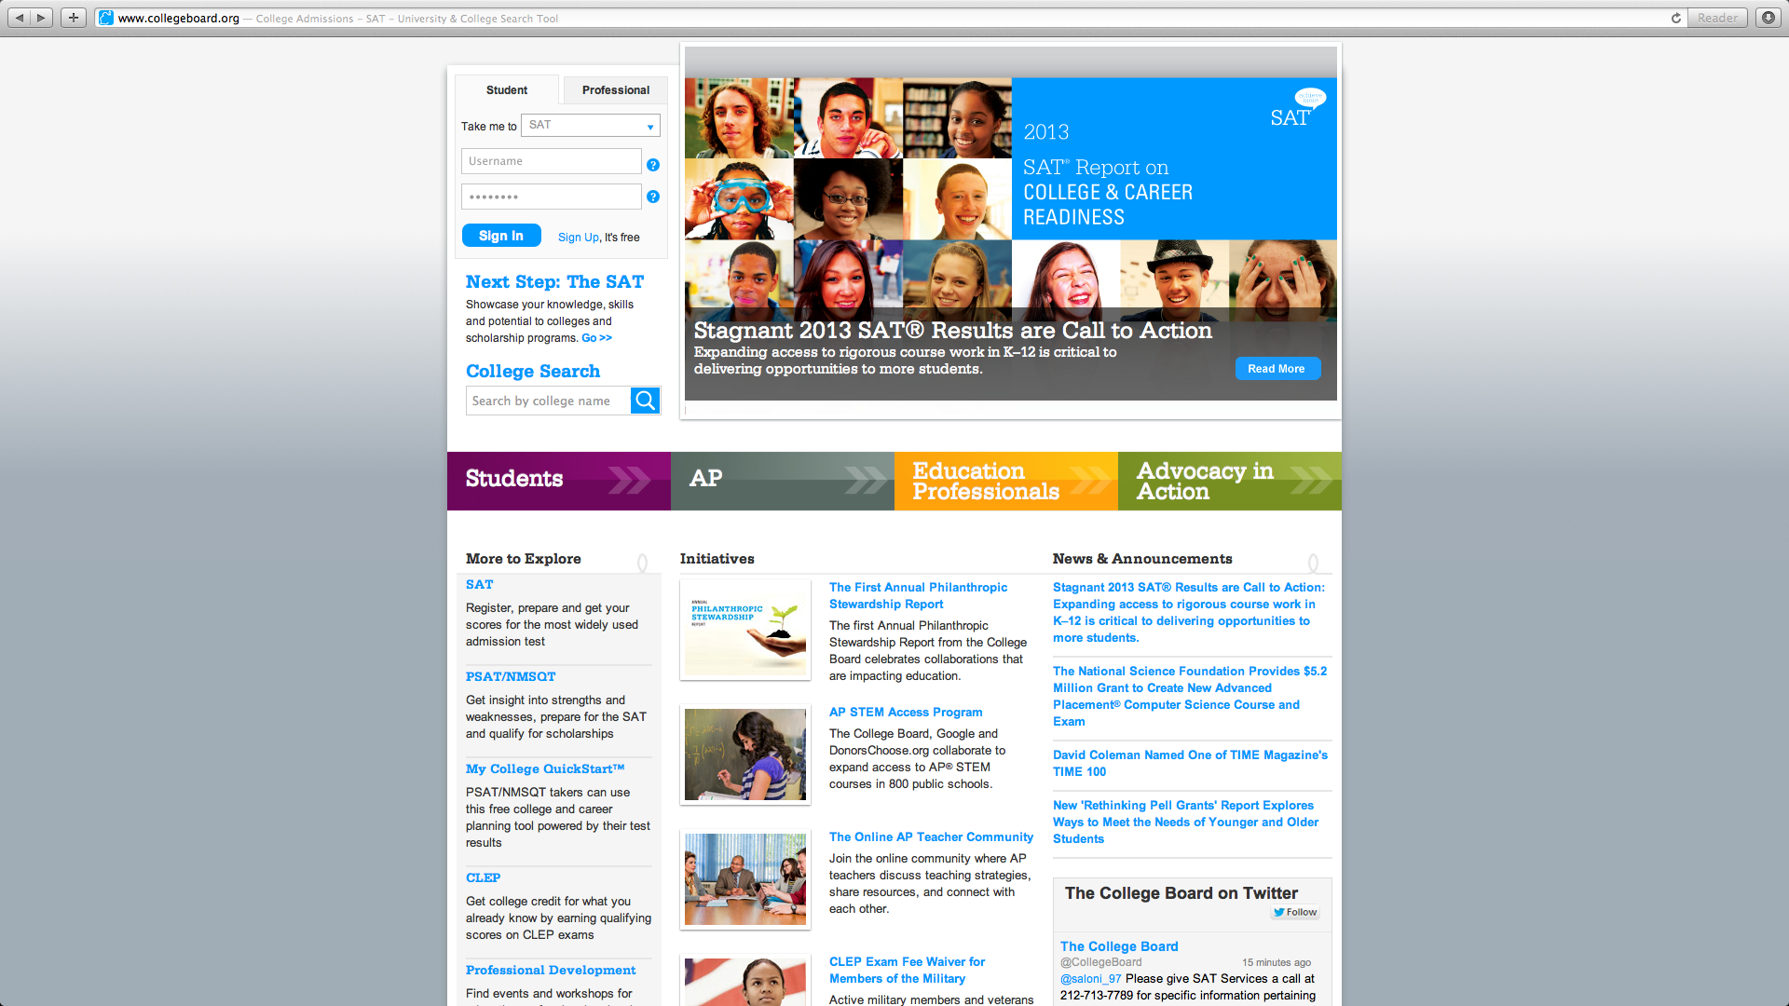
Front page of SAT website indicates call to action for stagnate 2013 SAT scores –
addressing this need to the K-12 community.
New Philanthropic Stewardship Report – collaborations with US Dept. of Ed. & Gates Fd.
Notes:
K-12 community is CCSS.

Slide 27
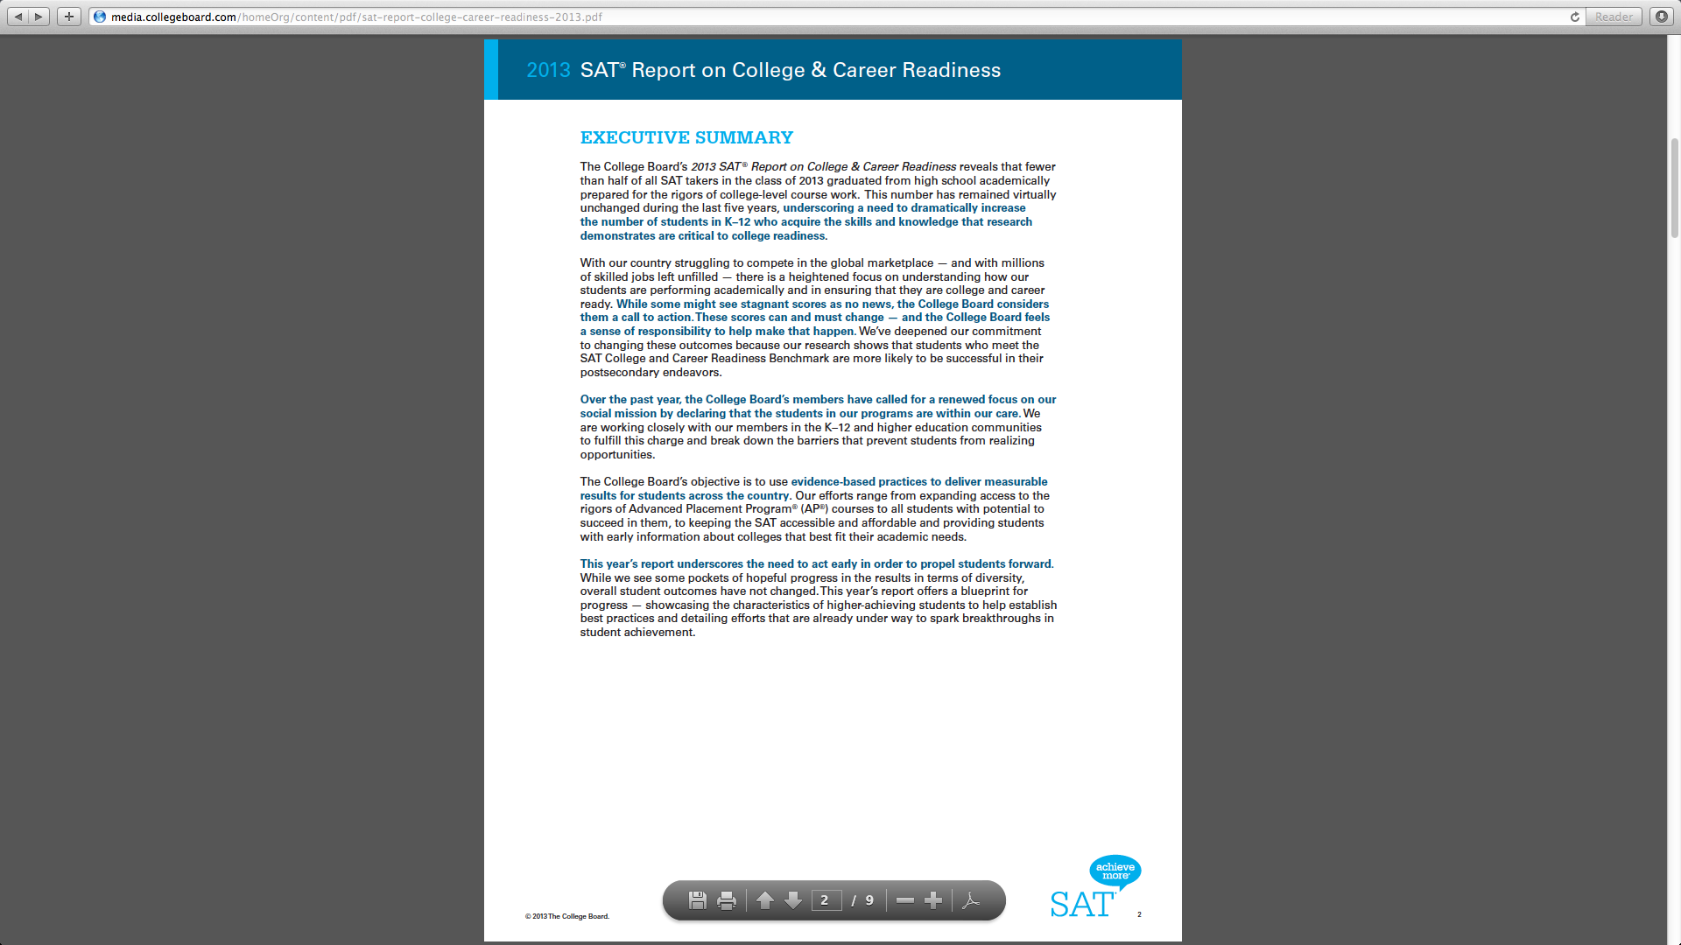
“Over the past year, the College Board’s members have called for a renewed focus on our social
mission by declaring that the students in our programs are within our care. We are working
closely with our members in the K-12 and higher education communities to fulfill this charge
and break down the barriers that prevent students from realizing opportunities.”
Notes:
This report is referenced on the front page of the SAT website. Some excerpts read “fewer than half of all SAT takers in the class of 2013 graduated from high school academically prepared for the rigors of college-level course work. This number has remained virtually unchanged during the last five years UNDERSCORING A NEED TO DRAMATICALLY INCREASE THE NUMBER OF STUDENTS IN K-12 WHO ACQUIRE THE SKILLS AND KNOWLEDGE THAT RESEARCH DEMONSTRATES ARE CRITICAL TO COLLEGE READINESS”.

Slide 28
Only means for college entry?
Nearly 850 Colleges and Universities have backed away from using the SAT/ACT as sole criteria for college entrance preferring to deemphasize their use and place a greater emphasis on student’s grades in high school as a more valid indictor of college success.
www.fairtest.org
Cromwell, A., McClarty, K., & Larson, S. (2013). College Readiness Indicators. Pearson.
Geiser, S., Santelices, M. (2007). Validity of high-school grades in predicting student success beyond the freshman year: High school record vs. standardized tests as indicators of four-year college outcomes. Research & Occasional Paper Series:CSHE.6.07 Berkeley, CA: Center for Studies in Higher Education.
Notes:
END HERE

Slide 29
Can a school use direct instruction or other traditional pedagogy and use these tests?
Iowa Form E – Yes.
Stanford 10 (New) – Yes. NCTM, IRA/NCTE
The question revolves around “rigor”.
Aspire – Unknown.
PARCC – no
Smarter Balance - no

Slide 30
College Board’s (SAT) 1st annual Philanthropic Stewardship Report July 1, 2011 – June 30, 2012
Report indicated total new funds granted during the year were $13,495,407 of which $10,454,125 (77%) were from the US Dept. of Education.
Total amount reported from all funds were $51,886,272 of which $14,056,150 are from the Bill & Melinda Gate Foundation (27%) and $10,454,125 (20%) were from US. Dept. of Ed.

